Slide 1

Validating causal inference in time series models with conditional-independence tests
James T Thorson, Jennifer Bigman, Cole Monnahan, Lauren Rogers

Slide 2
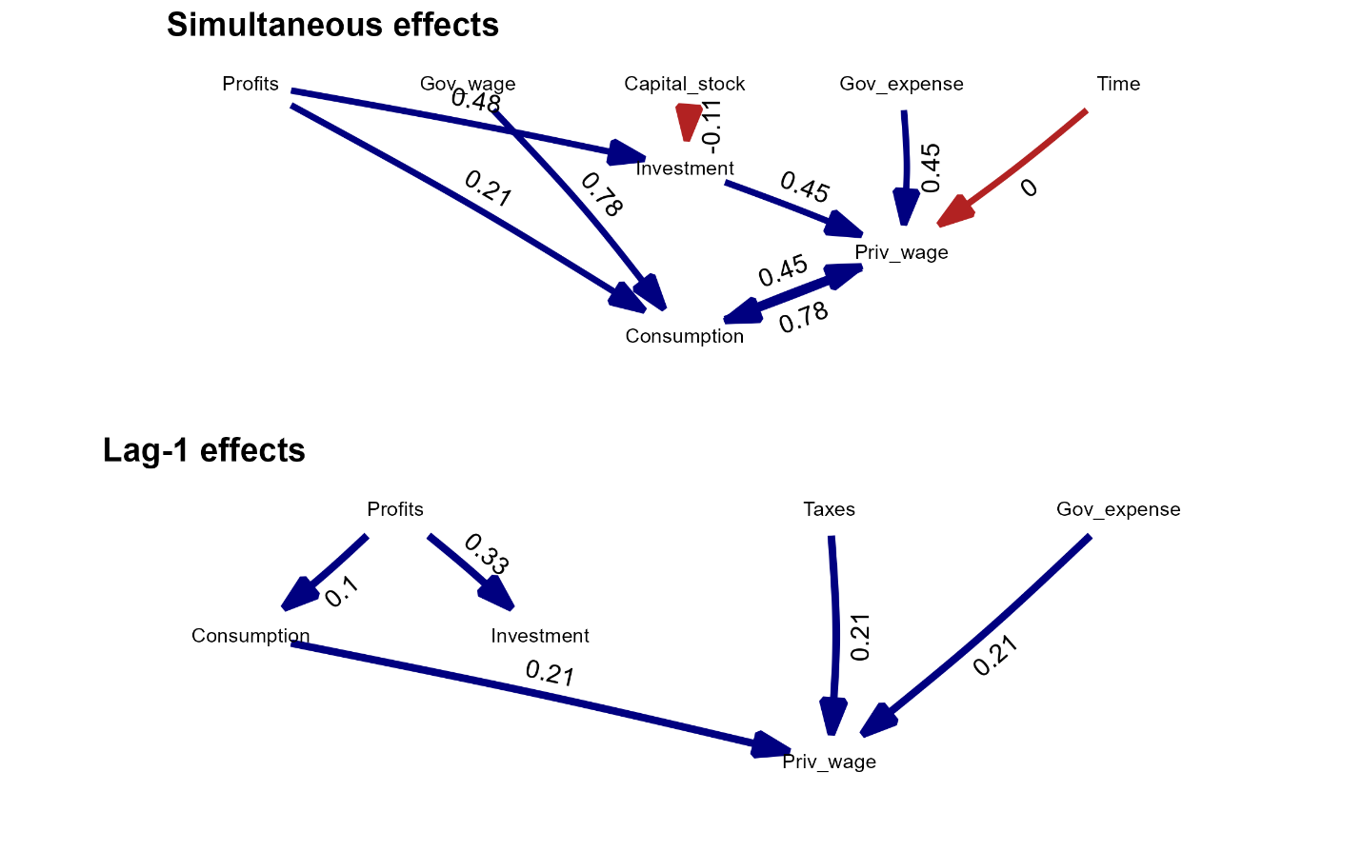
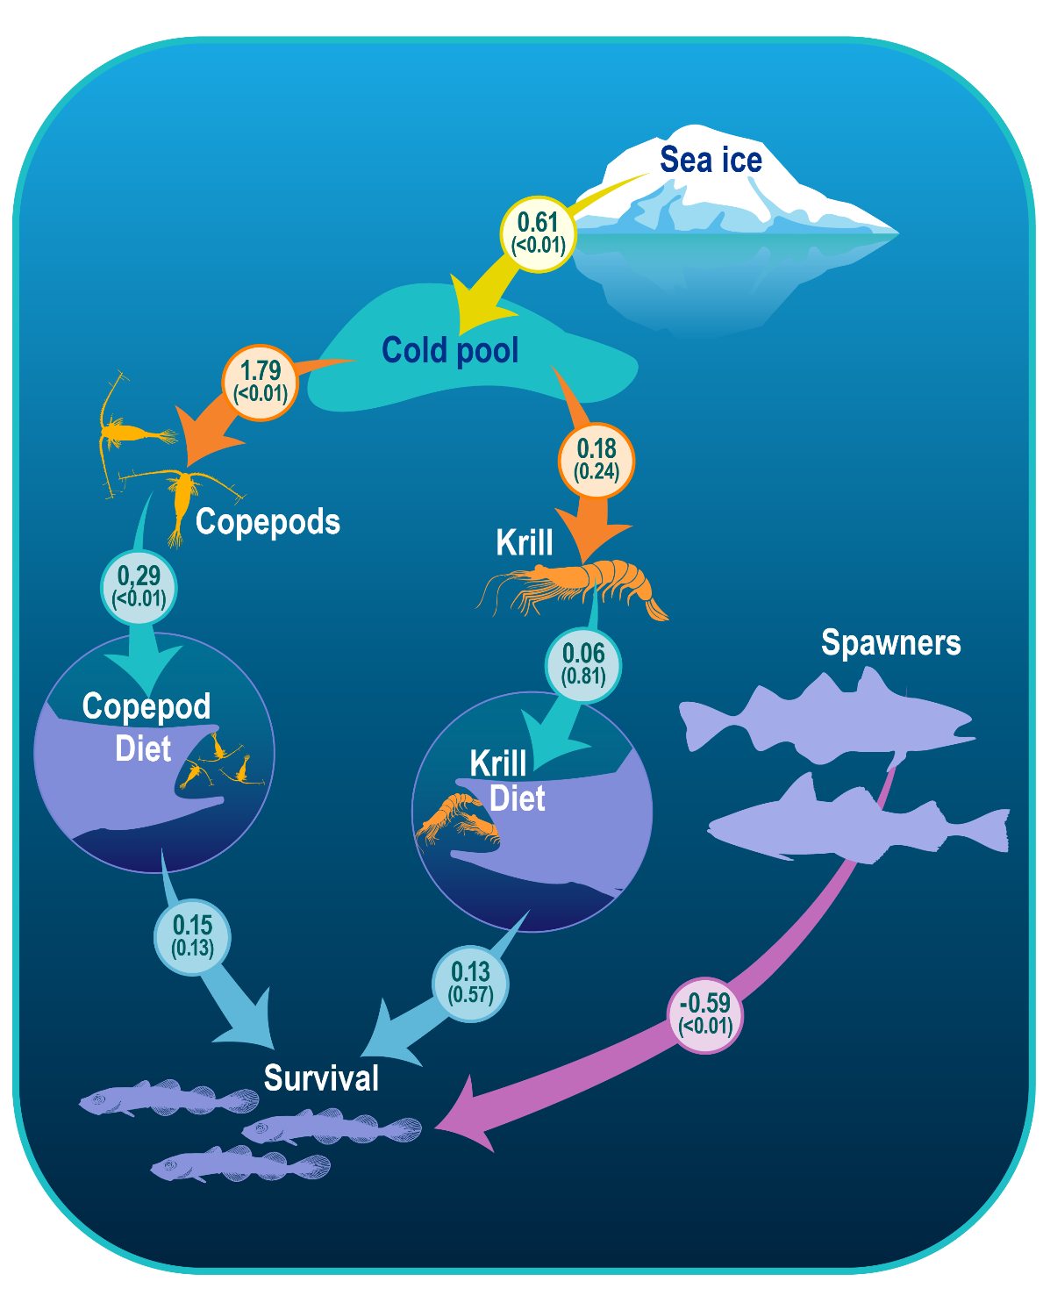
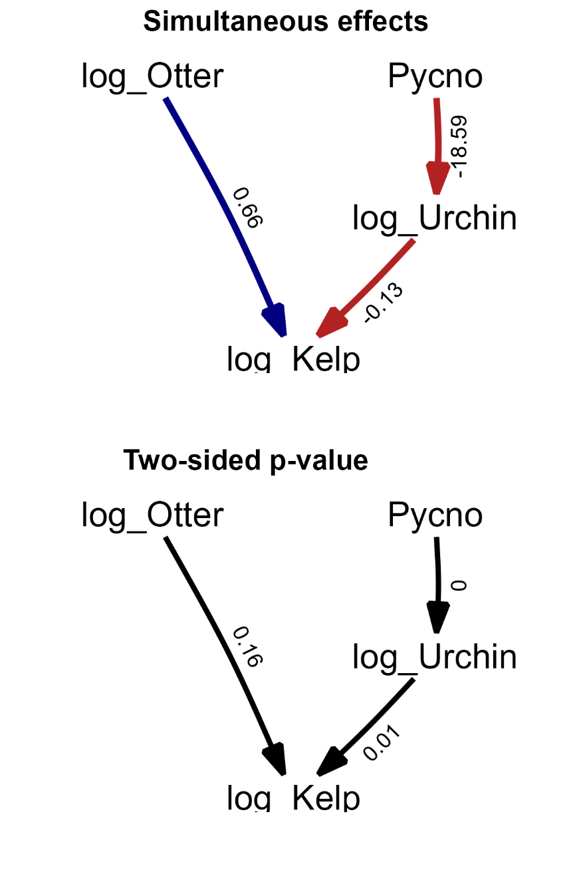
Macro-economics
Fisheries recruitment
Trophic cascade

Slide 3
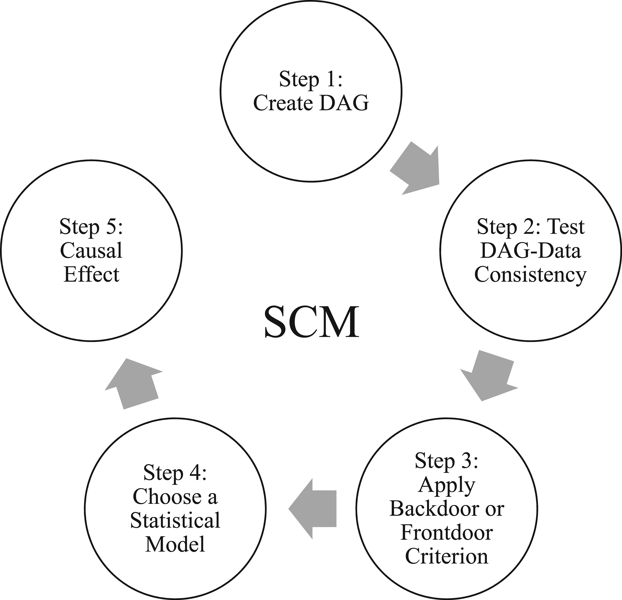
Arif, S., & MacNeil, M. A. (2023). Applying the structural causal model framework for observational causal inference in ecology. Ecological Monographs, 93(1), e1554.

Slide 4
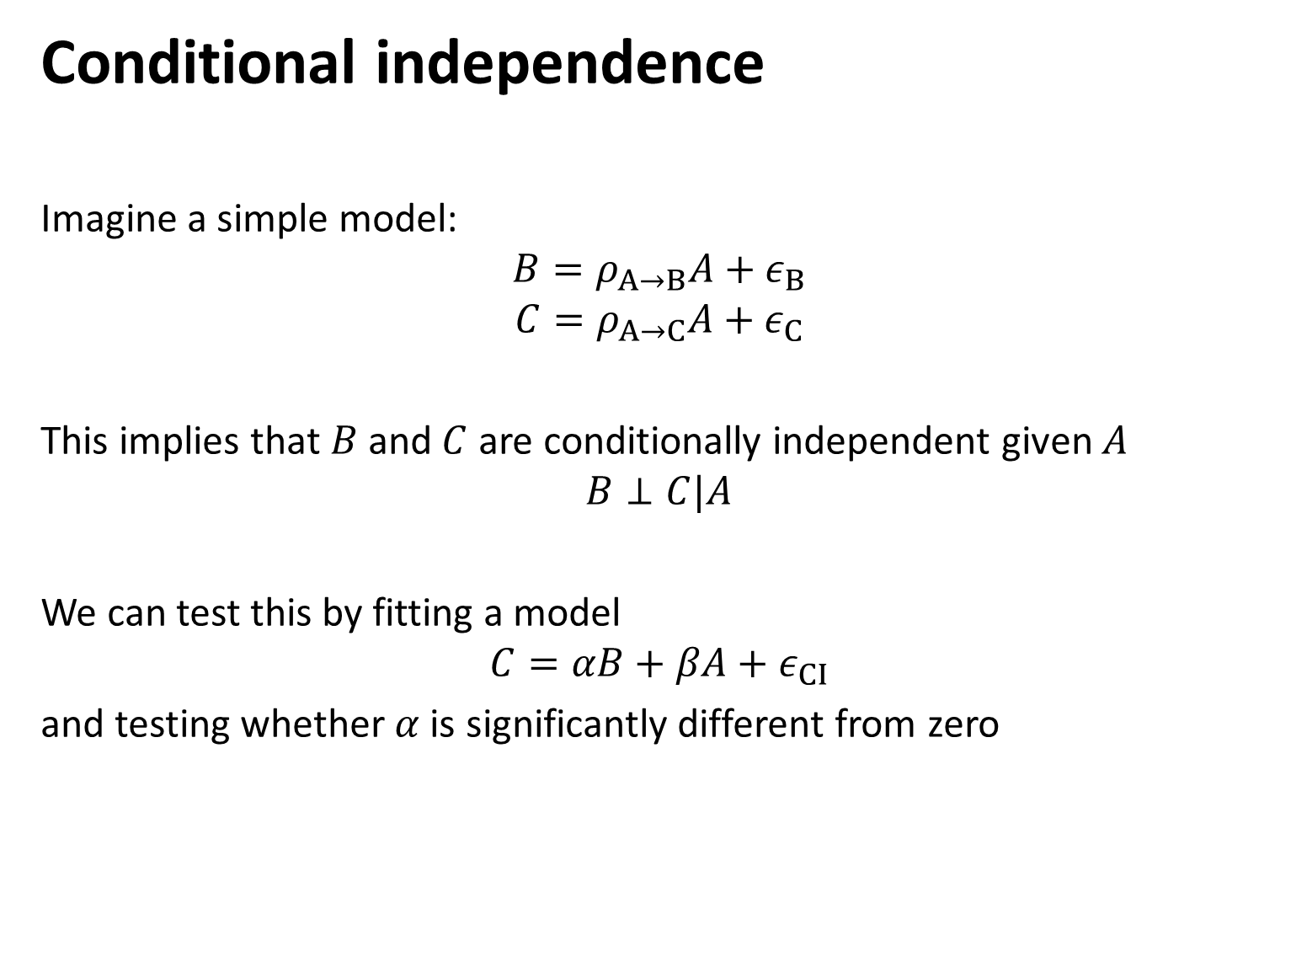
Conditional independence
Imagine a simple model:
$$B=ρ_{A→B}A+ε_{B}$$
$$C=ρ_{A→C}A+ε_{C}$$
This implies that $B$ and $C$ are conditionally independent given $A$
$$B⊥C|A$$
We can test this by fitting a model
$$C=αB+βA+ε_{CI}$$
and testing whether $α$ is significantly different from zero

Slide 5
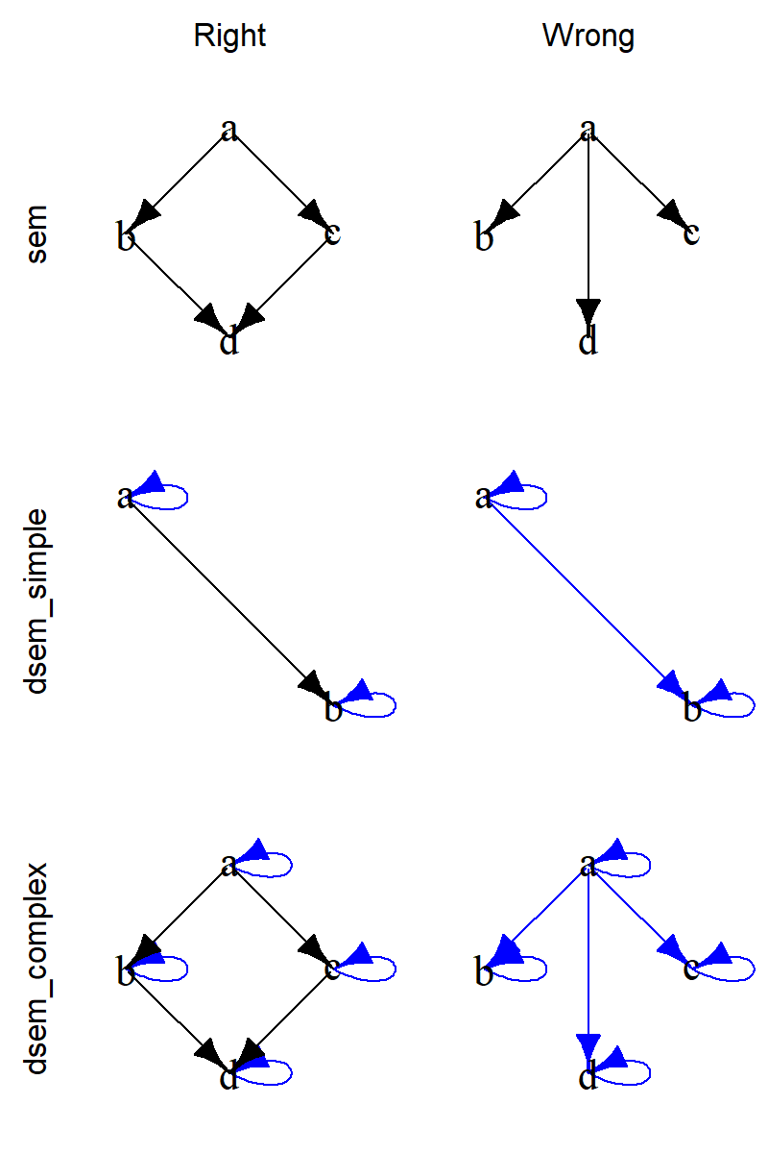
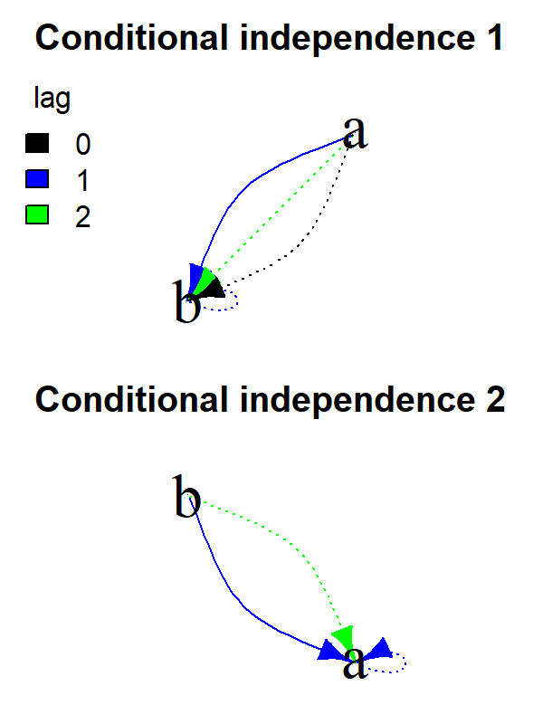
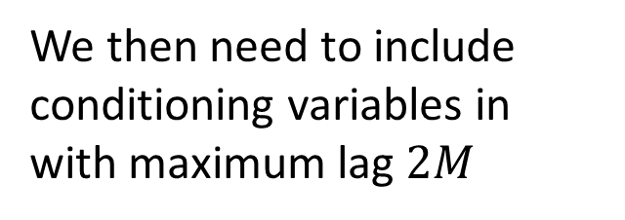
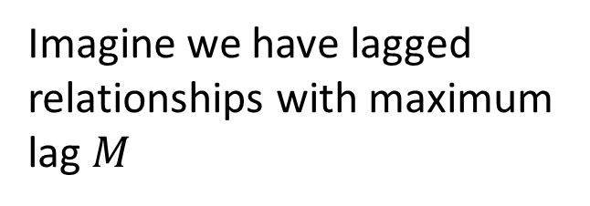
Conditional independence
Imagine we have lagged relationships with maximum lag $M$
We then need to include conditioning variables in with maximum lag $2M$
Simultaneous Lag-1

Slide 6
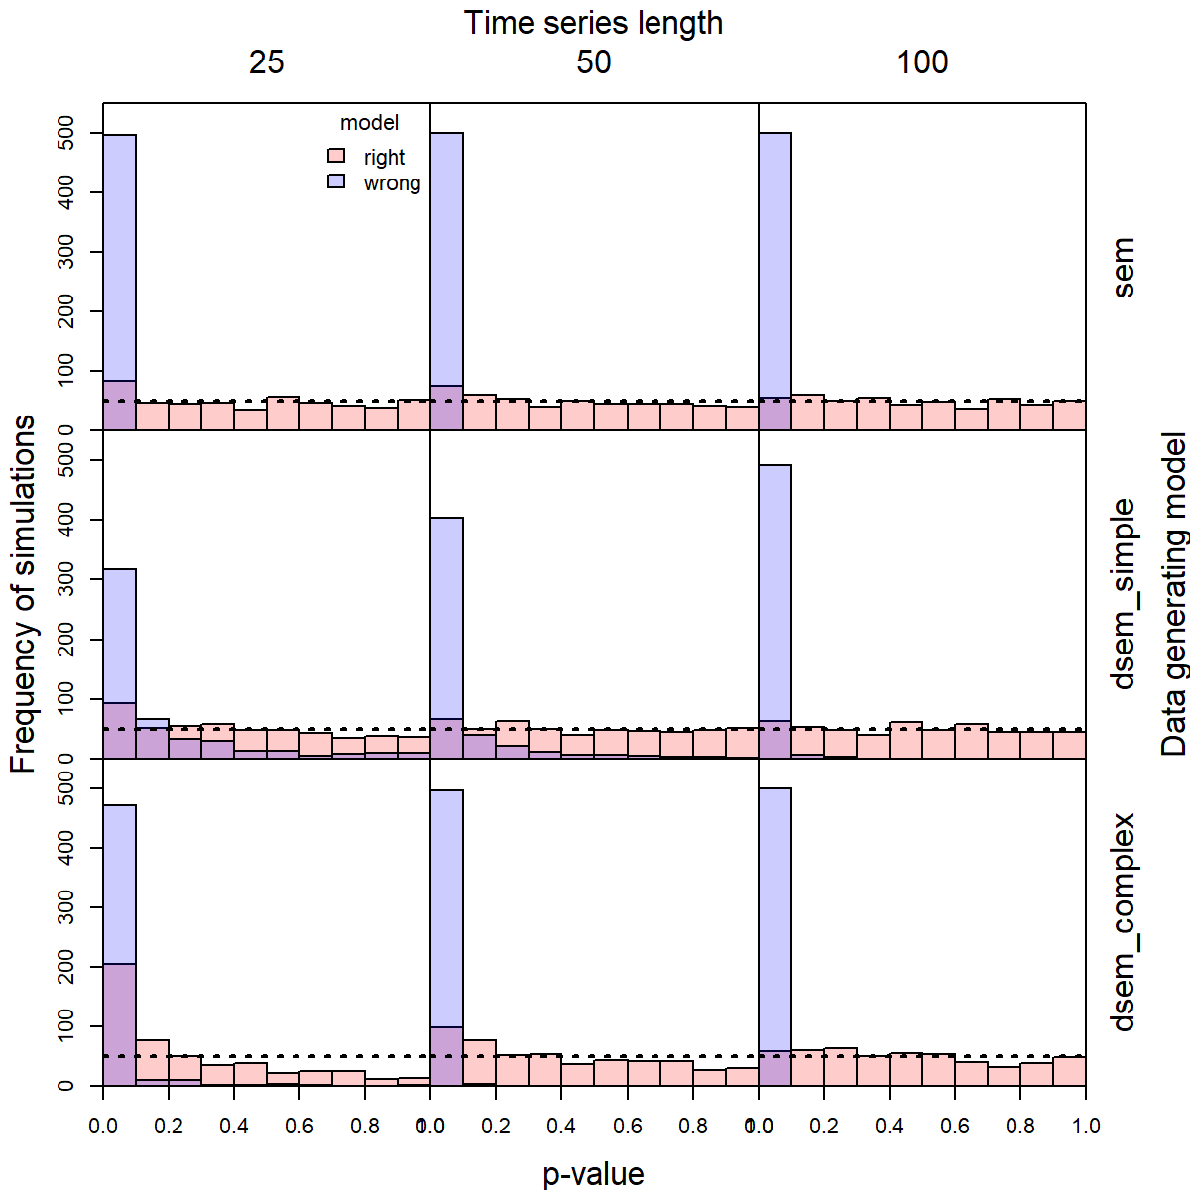
Simulation experiment
(no missing data)
P-values for 500 replicates with right or wrong model
Visualizing right and wrong model
Simultaneous Lag-1

Slide 7
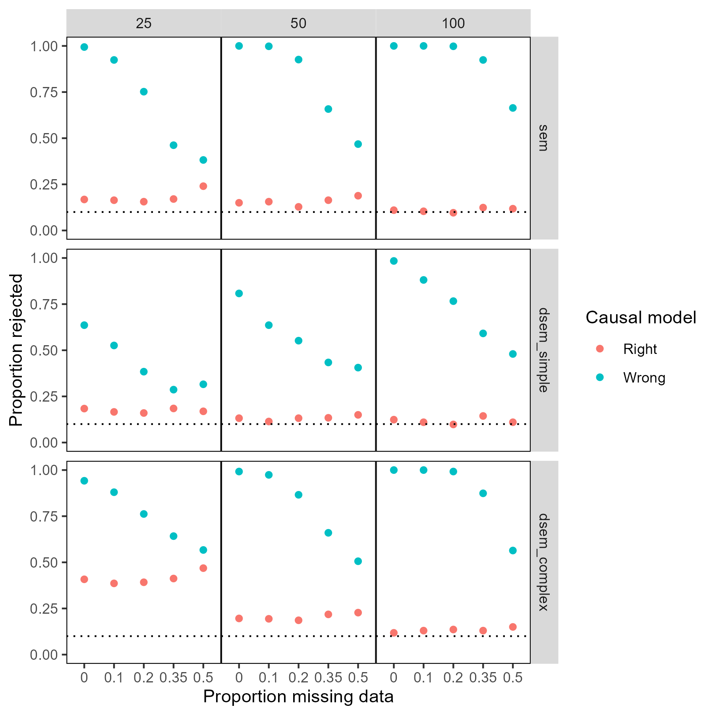
Simulation experiment
(with missing data)
Proportion rejected with missing data
Visualizing right and wrong model
Simultaneous Lag-1

Slide 8
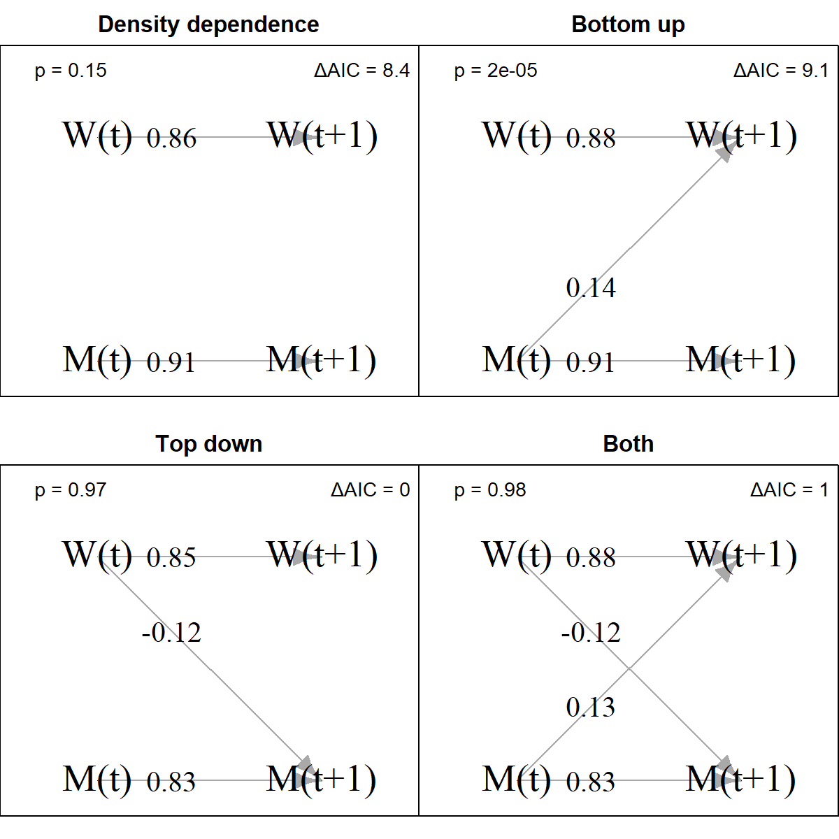
Case studies
Predator-prey interactions
Wolf and moose data on Isle Royale
Estimate bivariate vector autoregressive model
Test different lagged self and cross-lags
Result
Rejects models without top-down effects
Cannot distinguish whether bottom-up and top-down are both present

Slide 9
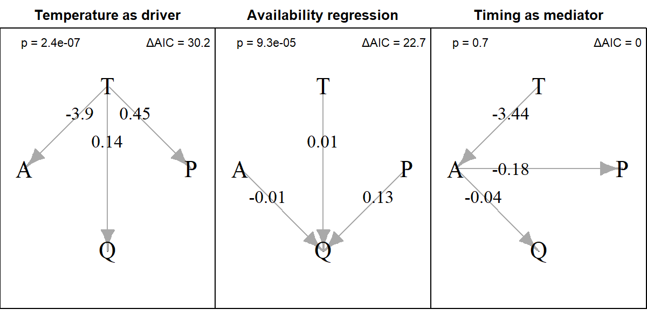
Survey availability
Bottom temperature (T)
Daily age of larvae during spring ichthyoplankton survey (A)
Gulf of Alaska pollock availability to winter acoustic survey (Q)
Proportion mature during acoustic survey (P)
Result
Temperature affects availability, which affects catchability
DATA FROM:
Rogers, L. A., Monnahan, C. C., Williams, K., Jones, D. T., & Dorn, M. W. (2025). Climate-driven changes in the timing of spawning and the availability of walleye pollock (Gadus chalcogrammus) to assessment surveys in the Gulf of Alaska. ICES Journal of Marine Science, 82(1), fsae005. https://doi.org/10.1093/icesjms/fsae005

Slide 10
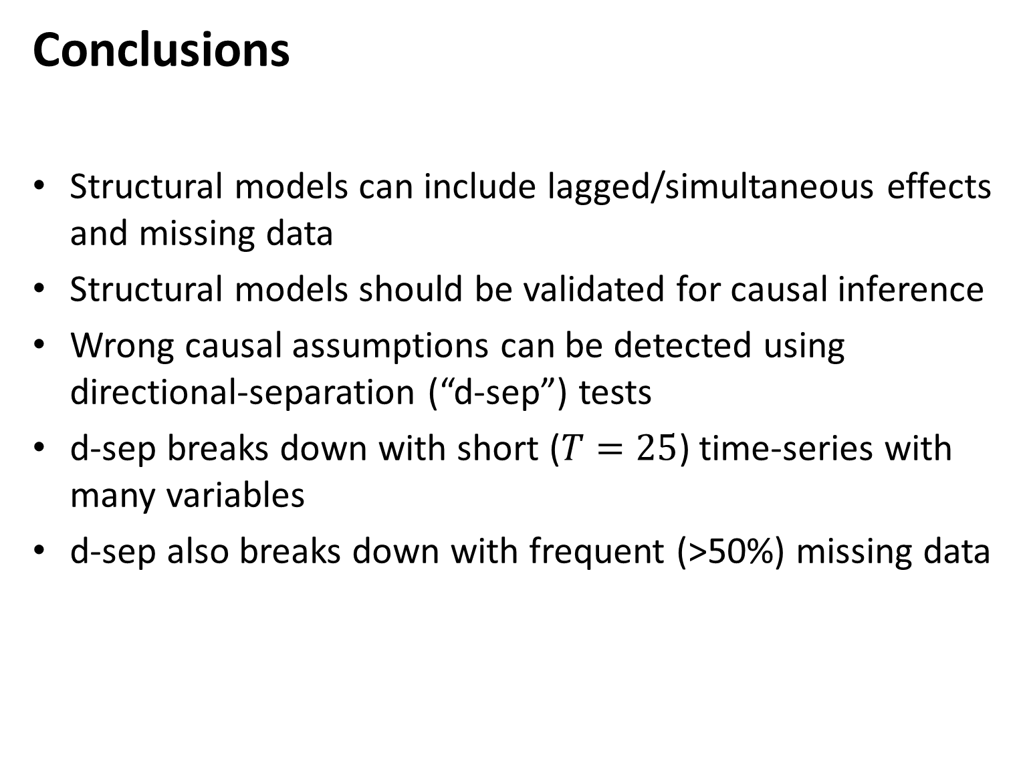
Conclusions
Structural models can include lagged/simultaneous effects and missing data
Structural models should be validated for causal inference
Wrong causal assumptions can be detected using directional-separation (“d-sep”) tests
d-sep breaks down with short ($T=25$) time-series with many variables
d-sep also breaks down with frequent (>50%) missing data

